Slide 1
Adam Flint: Director of Clean Energy Programs
Anna Purtell: Sustainable Energy Coordinator
Eve Marks, Jeremy Jordan: Energy Corps Interns
(607) 873-9220 | nynest.org | info@nynest.org

Slide 2
The Network for a Sustainable Tomorrow is a non-profit community-based network of programs working towards social, environmental, and economic justice and equity in our region. NEST catalyzes and convenes new initiatives and partnerships, and does outreach and education to build a stronger and more resilient Southern Tier.
nynest.org

Slide 3
Overview
What is Heat Smart Southern Tier?
Why HeatSmart?
HeatSmart Technologies
Weatherization and Home Energy Assessments
Heat Pump Technologies
Incentives & Financing
Steps for Participating

Slide 4
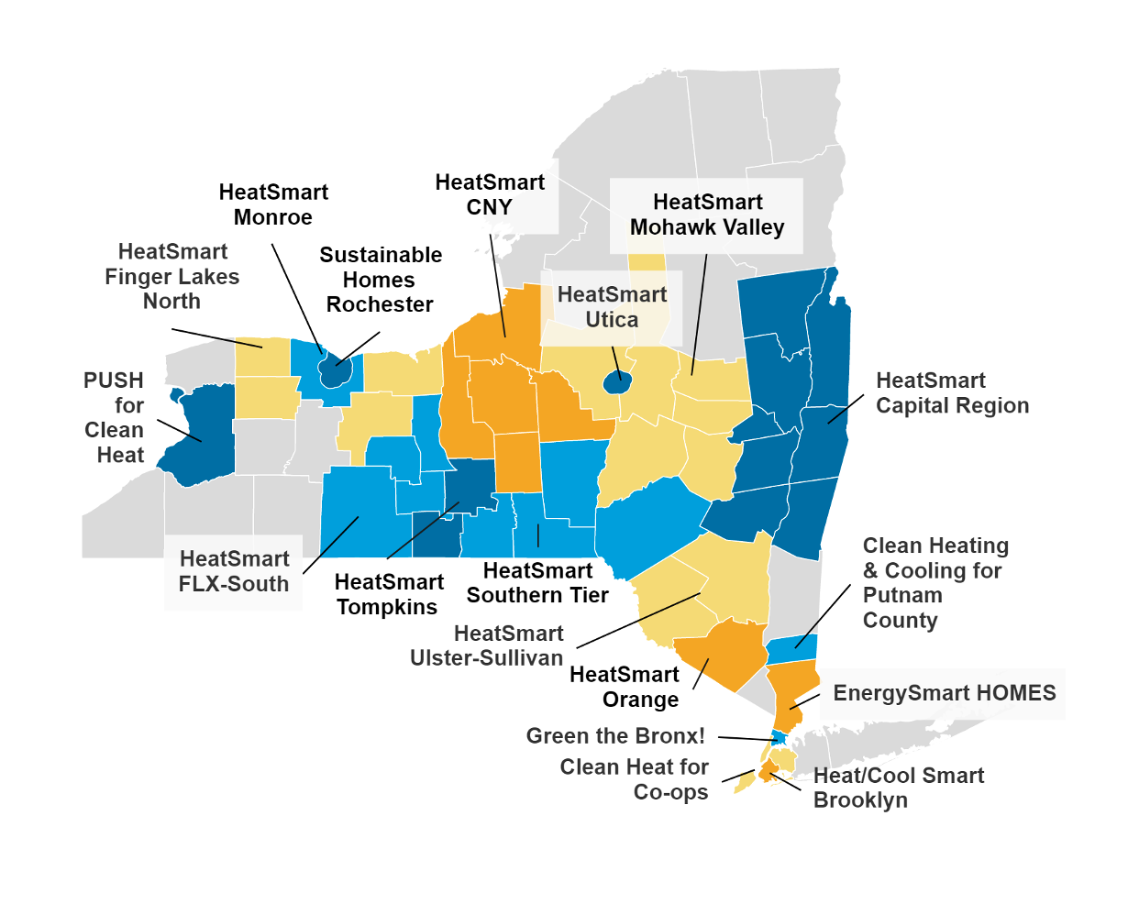
What is HeatSmart Southern Tier?
HeatSmart Southern Tier (HSST) is a NYSERDA-funded community outreach program that connects you to local heating and cooling and energy efficiency experts who offer the latest clean energy technologies
We work to educate the public about sustainable heating and cooling systems through our workshops, webinars and tabling events

Slide 5
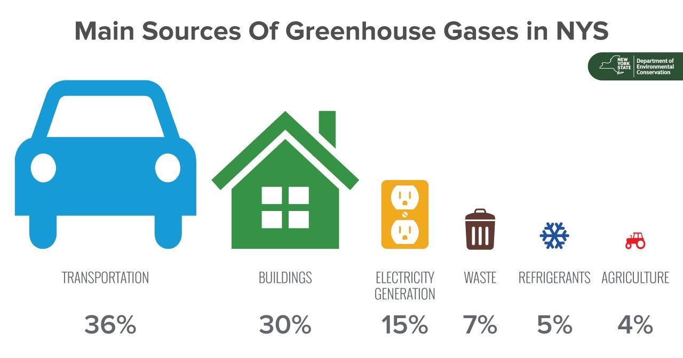
Where Are We Now?

Slide 6
Benefits of HeatSmart Southern Tier
Reduce energy costs
Home comfort & safety
Reduce greenhouse gas emissions
Community awareness
In our collaboration with the Fenton Clean Energy Communities program, the village can receive points toward monetary awards and other benefits

Slide 7
Clean Energy Communities (CEC)
The Clean Energy Communities program is run by NYSERDA that provides municipalities with the opportunity to be more sustainable in exchange for awards
Communities make energy efficiency and ‘green’ improvements to earn points. Once a community has earned a certain number of points, they receive an award

Slide 8
Fenton CEC
Fenton is a participating Clean Energy Community and you can help support the Town’s sustainability goals!
As residents sign up for our HeatSmart program, Fenton gets closer to reaching their clean energy goals and receiving grant money from NYS
Getting just five residents to sign contracts for energy efficiency improvements and heat pump installations benefits CEC campaigns, such as Fenton’s

Slide 9
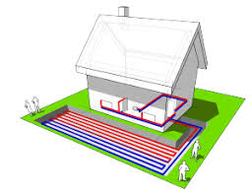
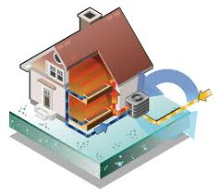
HeatSmart Southern Tier Program Covers:
Weatherization
Heat Pumps
Ground Source
Air Source
Water Heater

Slide 10
HeatSmart Southern Tier’s
Competitively Selected Partners
Air Source Heat Pumps
Ground Source Heat Pumps
Home Performance and Efficiency
Pending New Partnership
(Delaware County)
(Delaware County)
(Delaware County)

Slide 11
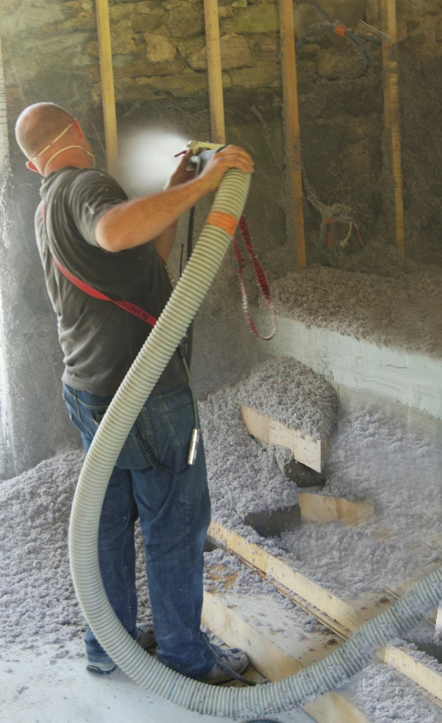
Weatherization Benefits
Reduce energy consumption and costs
Increase home safety
Improve home comfort
Reduce drafts
Improve humidity control
Improve indoor air quality
Reduce risk of ice dams

Slide 12
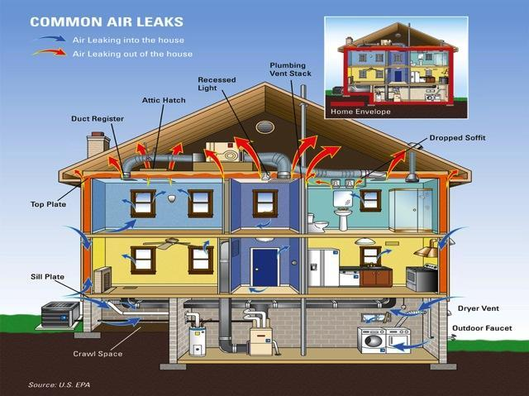

Slide 13
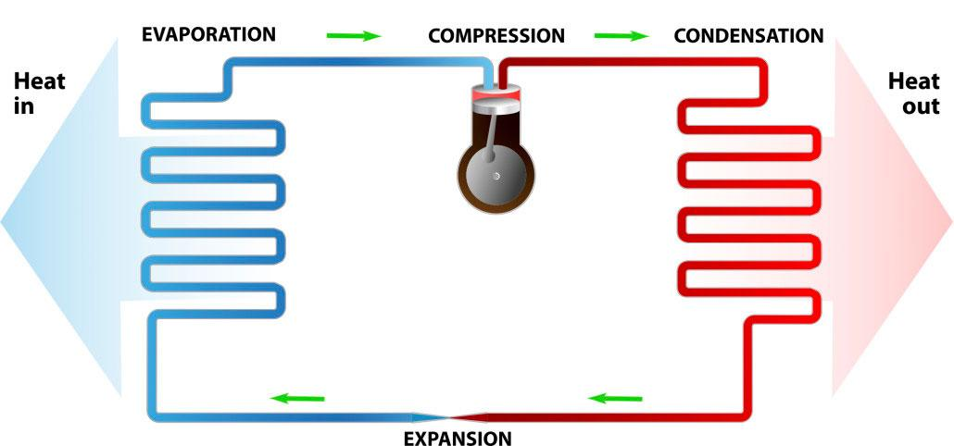
What is a Heat Pump?

Slide 14
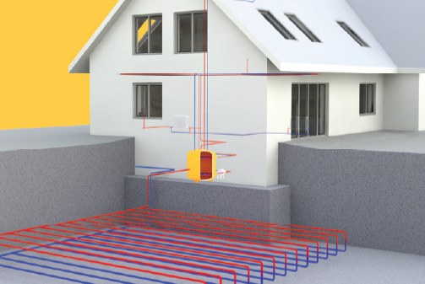
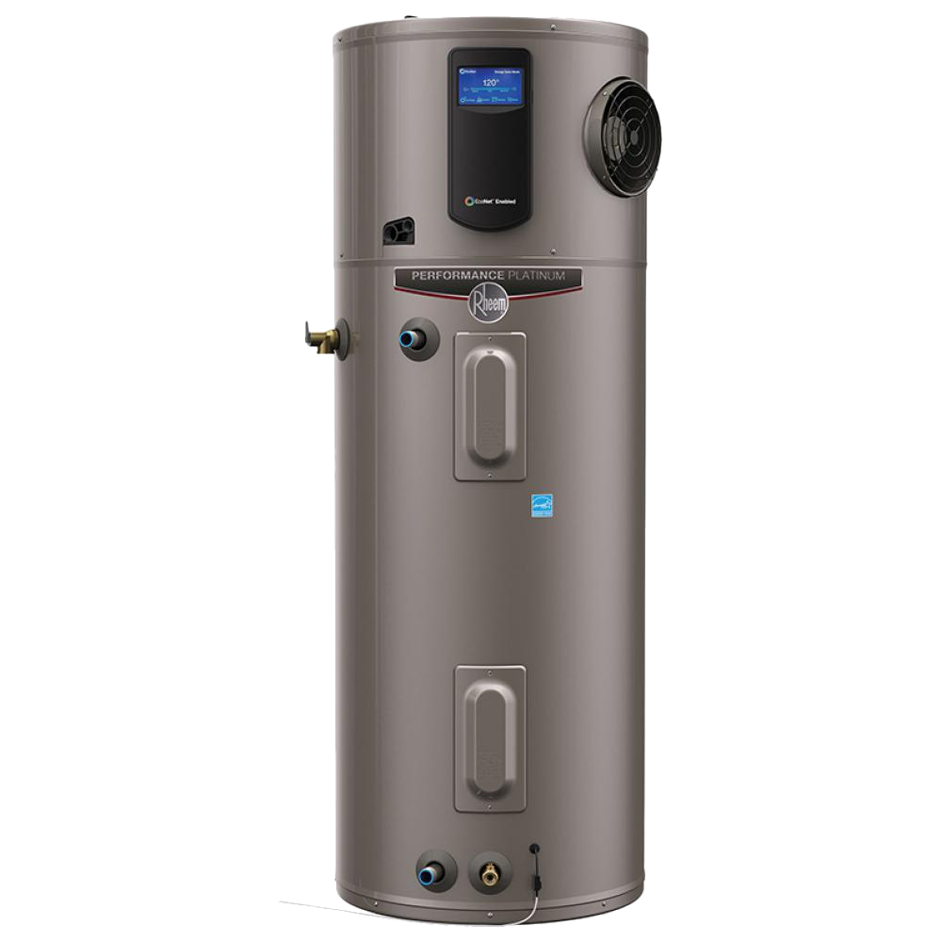
Types of Heat Pumps
Space Heating & Cooling
Hot Water Heating
Ground Source
Heat Pump
Air Source Heat Pump
Heat Pump
Water Heater

Slide 15
Types of Ground Source Heat Pumps
Closed Loop
Horizontal
Vertical

Slide 16
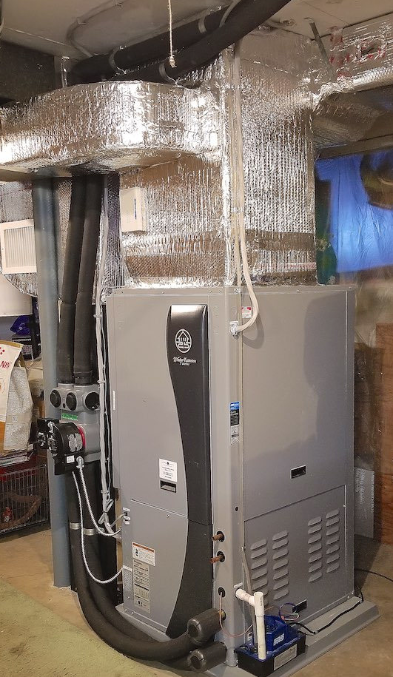
Ground Source Heat Pump Benefits
An efficient heating/cooling system
Long system lifetime
Eliminate fossil fuels from your home
Can include domestic hot water

Slide 17
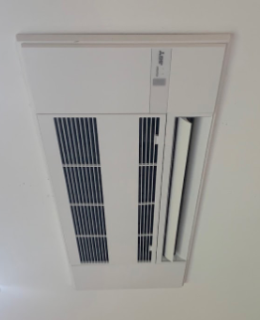
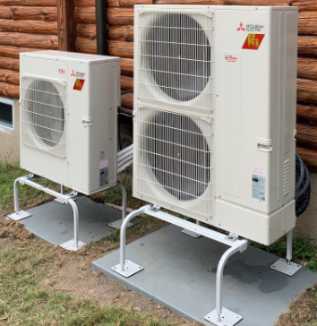
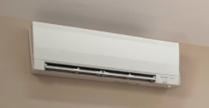
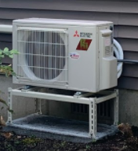
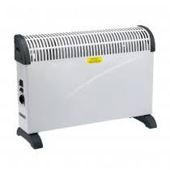
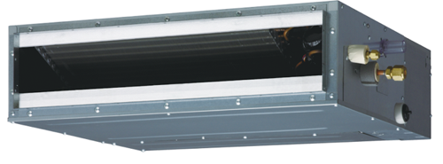
Air Source Heat Pumps
Ductless Heat Pumps
Outdoor Units
Indoor Units
Wall Mount
Ceiling Cassette
Floor Mount
Mini Duct

Slide 18
Air Source Heat Pumps Benefits
Energy savings
Full heating replacement not required
Flexible
Zone control
Air conditioning without ductwork
Quiet

Slide 19
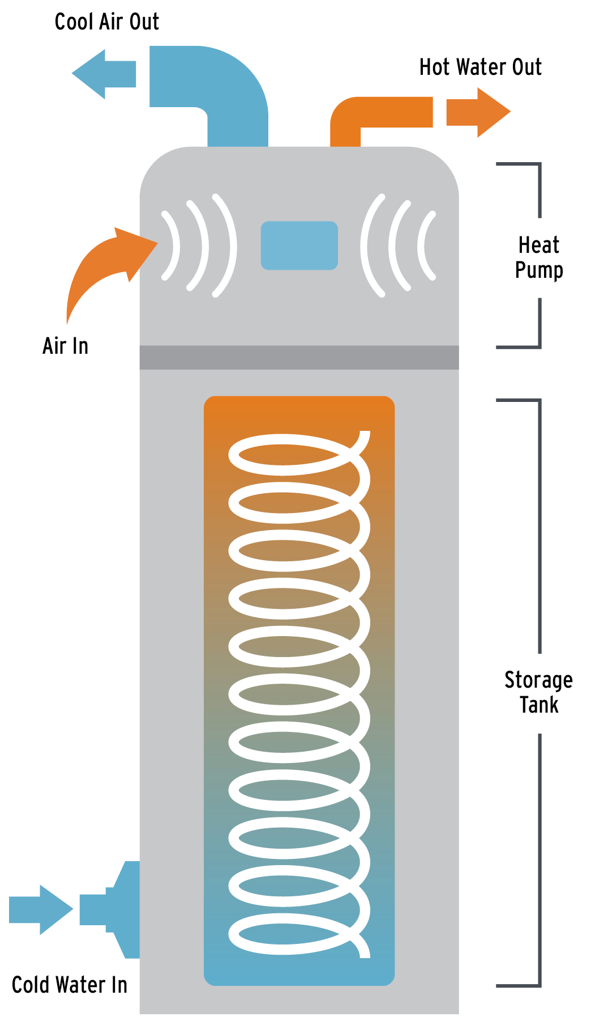
Heat Pump Water Heaters
Uses indoor air to heat your hot water
Has backup for meeting high demand
Benefits
More efficient than typical electric water heaters
Provides dehumidification

Slide 20
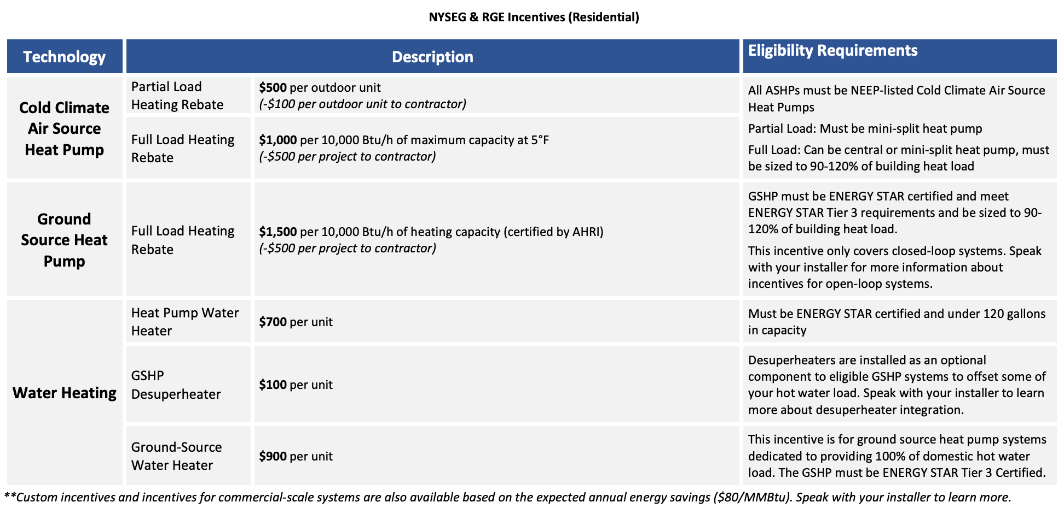
INCENTIVES and FINANCES

Slide 21
Heat Pump Tax Credits
 | Air Source Heat Pump | Ground Source Heat Pump | Heat Pump Water Heater
Federal Tax Credit | $300 | 30% | $300
State Tax Credit | — | 25%, up to $5,000 | —

Slide 22
Financing
Provider | Loan Product Name | Description
NYSERDA* | Smart Energy Loan | Up to $25,000; terms of 5, 10, and 15 years; 3.49 or 6.99% interest
 | On-Bill Recovery Loan | Up to $25,000; terms of 5, 10, and 15 years; 3.49 or 6.99% interest; paid on utility bill
 | Companion Loan | Up to $25,000; terms of 5, 10, and 15 years; 6.99% interest additional to OBR or SEL for larger work scopes. Cost effectiveness & other requirements apply. *
ASHP/GSHP Manufacturer Financing (E.g. Synchrony, EnerBank) |  | Unsecured loans with dealer fees (can be terms of up to 20 years)
Local Banks (e.g. Home Equity, consumer loans) |  | Dependent on bank

Slide 23
Enabling Low and Moderate Income (LMI) Participation: Income-eligible programs
Assisted Home Performance with Energy Star Energy Efficiency/Weatherization
Household Size | Income Limit
1 | $43,664
2 | $57,104
3 | $70,554
4 | $83,984
5 | $97,408
6 | $110,848
Provides those who apply with a discount of 50% of project costs
Limit of $5,000 for single-family
Limit of $10,000 for 2-4 unit multi-family
Includes heat pumps
(Income levels subject to change)

Slide 24
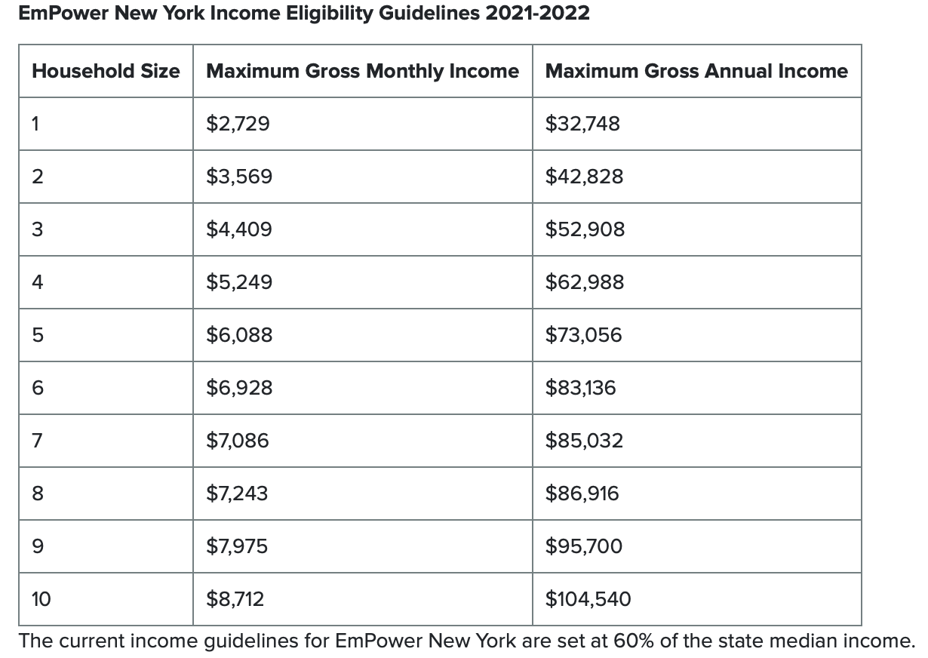
Enabling LMI Participation: Income-eligible programs
EmPower NY Energy Efficiency/Weatherization
Available to homeowners that are under 60% of state median income that pay utility bills
up to $10,000 off
Includes heat pumps
(Income levels subject to change)

Slide 25
Home Energy Audits
Residential Energy Audit (REAP Audit)
Free for anyone, but does not include diagnostic testing
Full Energy Audit including diagnostic testing
Market rate: Must pay fee
LMI: Must fill out joint application & have project done in order to be free
Diagnostic testing such as IR cameras

Slide 26
Steps for Participating
Sign up for a home energy assessment (and/or) sign up for a heat pump site assessment from HSST installer
Fill out the enrollment form
We will connect you with the appropriate installer
Receive a quote for energy improvements
Apply for incentives/financing (if applicable)
Sign contract for desired systems (if any)
Complete installation work

Slide 27
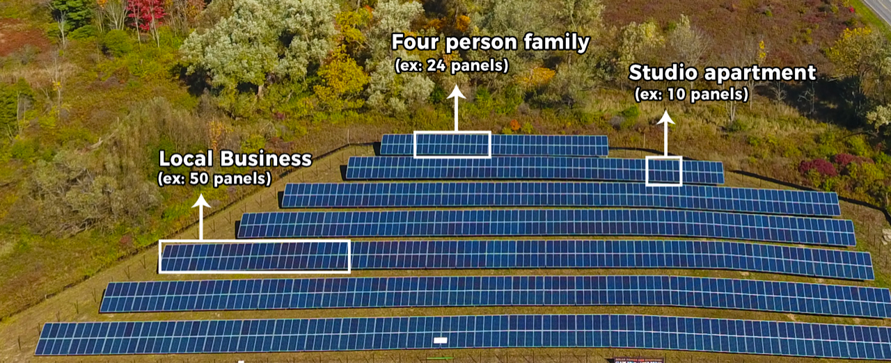
Dickinson Project:
LMI Community Shared Solar

Slide 28
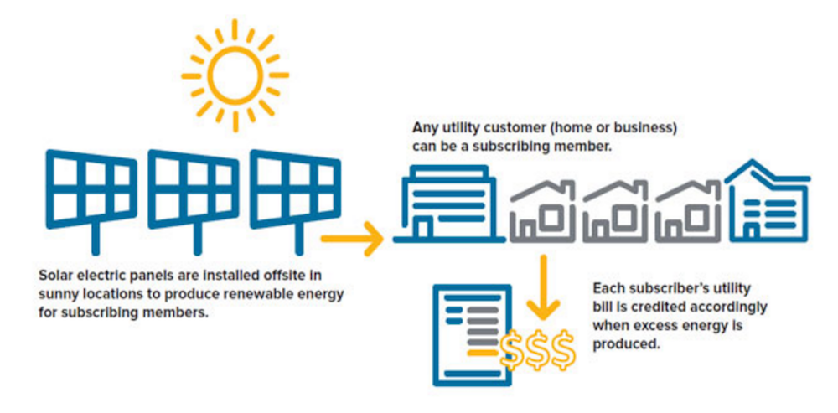
Receive 20% savings annually on your NYSEG bill.
Support locally produced renewable electricity & union jobs
Pre-enroll today to get your place in the queue!
Income qualification required
Join with no upfront cost or fees
Benefits and How It Works

